Slide 1
Stable and Flexible iBGP
Lu Ren
Advisor: Prof. Boon Thau Loo
Sept. 26th, 2011

Slide 2
Overview
Introductions
Oscillation Scenarios
Routing Algebra
Route-Reflection Algebra
Multiple Routes for MED
Q&A

Slide 3
Presenter: Lu Ren
Master Candidate at Penn
BS degree at Tsinghua University, Beijing, China;
Mainly work on networking;
Graduate December, 2012;
Work at Bank of America after Graduation;
luren@seas.upenn.edu

Slide 4
Introduction
Why this paper?
Context
Oscillation/Unstability in iBGP
Routing Algebra is well developed
Strict Monotonicity has been proved to guarantee stability
MED is widely used;
This paper
Presents oscillation and its causes;
Develops a routing algebra based on the current algebra;
Studies how the routing algebra could be used to analyze real network;
Suggests improvements to solve the oscillation problem;

Slide 5
Introduction
Border Gateway Protocol
External BGP(eBGP)
Internal BGP(iBGP)
eBGP
iBGP
iBGP
eBGP
eBGP
iBGP
Source: made by Alex Gurney in BGP Lecture
Notes:
When BGP runs inside an autonomous system (AS), it is referred to as Internal BGP (IBGP or Interior Border Gateway Protocol). When it runs between autonomous systems, it is called External BGP (EBGP or Exterior Border Gateway Protocol). Routers on the boundary of one AS exchanging information with another AS are called border or edge routers. In the Cisco operating system, IBGP routes have an administrative distance of 200, which is less preferred than either external BGP or any interior routing protocol. Other router implementations also prefer EBGP to IGPs, and IGPs to IBGP.

Slide 6
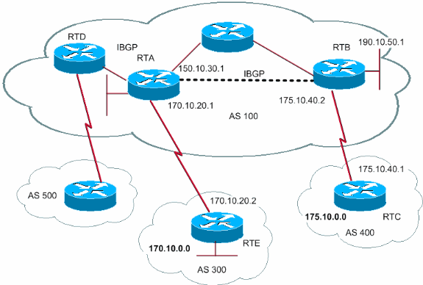
Introduction
iBGP
Source: cisco.com

Slide 7
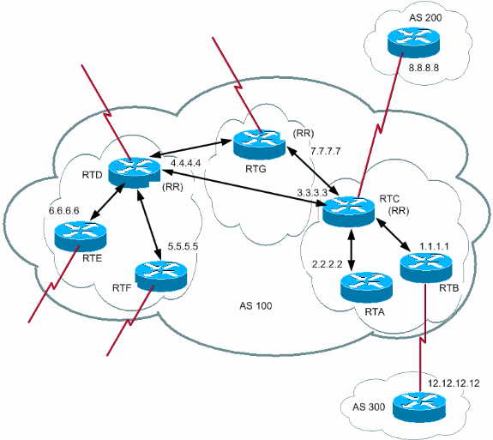
Introduction
Route Reflector
Source: cisco.com

Slide 8
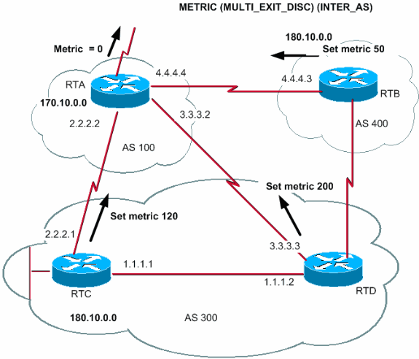
Introduction
MED
Source: cisco.com
Notes:
The metric attribute also has the name MULTI_EXIT_DISCRIMINATOR, MED (BGP4), or INTER_AS (BGP3). The attribute is a hint to external neighbors about the path preference into an AS. The attribute provides a dynamic way to influence another AS in the way to reach a certain route when there are multiple entry points into that AS. A lower metric value is preferred more.
Unlike local preference, metric is exchanged between ASs. A metric is carried into an AS but does not leave the AS. When an update enters the AS with a certain metric, that metric is used to make decisions inside the AS. When the same update passes on to a third AS, that metric returns to 0. The diagram in this section shows the set of metric. The metric default value is 0.

Slide 9
Oscillation
MED Oscillation
Topology Oscillation

Slide 10
Oscillation
MED Oscillation
AS1
0
1
2
3
4
AS2
AS3
AS4

Slide 11
Oscillation
MED Oscillation
0
1
0
Route Reflector
1
4
Border Router
2
4
1
iBGP Session
2
3
4
30
30
20
Ingress MED

Slide 12
Oscillation
MED Oscillation – Stage 0
R0’s routing table
0
1
AS_PATH | MED | IGP Cost
2 | - | 2
3* | 30 | 1
1
2
4
1
R1’s routing table
2
3
4
AS_PATH | MED | IGP Cost
4* | 20 | 4
30
20

Slide 13
Oscillation
MED Oscillation – Stage 1
R0’s routing table
0
1
AS_PATH | MED | IGP Cost
2* | - | 2
3 | 30 | 1
4 | 20 | 5
1
2
4
1
2
3
4
R1’s routing table
30
20
AS_PATH | MED | IGP Cost
4* | 20 | 4

Slide 14
Oscillation
MED Oscillation – Stage 2
R0’s routing table
0
1
AS_PATH | MED | IGP Cost
2* | - | 2
3 | 30 | 1
4 | 20 | 5
1
2
4
1
R1’s routing table
2
3
4
AS_PATH | MED | IGP Cost
4 | 20 | 4
2* | - | 3
30
20

Slide 15
Oscillation
MED Oscillation – Stage 3
R0’s routing table
0
1
AS_PATH | MED | IGP Cost
2 | - | 2
3* | 30 | 1
4 | 20 | 5
1
2
4
1
R1’s routing table
2
3
4
AS_PATH | MED | IGP Cost
4 | 20 | 4
2* | - | 3
30
20

Slide 16
Oscillation
MED Oscillation – Stage 4
R0’s routing table
0
1
AS_PATH | MED | IGP Cost
2 | - | 2
3* | 30 | 1
1
2
4
1
R1’s routing table
2
3
4
AS_PATH | MED | IGP Cost
4* | 20 | 4
2 | - | 3
3 | 30 | 2
30
20

Slide 17
Oscillation
MED Oscillation – Stage 5
R0’s routing table
0
1
AS_PATH | MED | IGP Cost
2* | - | 2
3 | 30 | 1
4 | 20 | 5
1
2
4
1
R1’s routing table
2
3
4
AS_PATH | MED | IGP Cost
4* | 20 | 4
3 | 30 | 2
30
20

Slide 18
Oscillation
MED Oscillation – Stage 6
R0’s routing table
0
1
AS_PATH | MED | IGP Cost
2* | - | 2
3 | 30 | 1
4 | 20 | 5
1
2
4
1
R1’s routing table
2
3
4
AS_PATH | MED | IGP Cost
4 | 20 | 4
3 | 30 | 2
2* | - | 3
30
20

Slide 19
Oscillation
MED Oscillation – Stage 7 (same as Stage 2)
R0’s routing table
0
1
AS_PATH | MED | IGP Cost
2* | - | 2
3 | 30 | 1
4 | 20 | 5
1
2
4
1
R1’s routing table
2
3
4
AS_PATH | MED | IGP Cost
4 | 20 | 4
2* | - | 3
30
20

Slide 20
Oscillation
Topology Oscillation
0
2
1
5
5
10
10
10
5
4
5
6

Slide 21
Oscillation
Topology Oscillation
0
1
a
b
4
c
d
2
3

Slide 22
Routing Algebra
To prevent the oscillation, we need to analyze the nature of BGP and the causes for oscillation
One way for analyzing is using routing algebra

Slide 23
Routing Algebra
We abstract routing protocol as routing algebra;
Strict monotonicity in the routing algebra ensures the preference of a route strictly decreases when it is propagated;
Previous work has shown that if a routing algebra is strictly monotonic, then the protocol is correct and convergence is guaranteed;

Slide 24
Routing Algebra
Each route has a signature $σ∈Σ$;
Each link has a label $λ∈L$
A function that converts a route signature to weight that can be compared;
Strict monotonicity: for all $σ∈Σ−\left\{φ\right\}$, and for all $λ∈L$, $f\left(σ\right)≺f\left(λ⨁σ\right)$
$≺$ operator means the former is strictly preferred to the latter;

Slide 25
Route-Reflection Algebra
Edge Type
over
0
1
up
down
2
3
4

Slide 26
Route-Reflection Algebra
Scenario
(o, 1)
0
(o, 0)
1
(u, 0)
(d, 3)
(u, 0)
(u, 1)
(d, 4)
(d, 2)
2
(o, 2)
3
4
(o, 3)
(u, 2)
(d, 6)
(u, 3)
(u, 3)
(d, 9)
(d, 5)
(d, 8)
(u, 4)
(u, 2)
(d, 7)
5
6
7
8
9

Slide 27
Route-Reflection Algebra
Basic Algebra
$$Σ=\{d, u, o, e\}×ℤ^{+}×ℤ^{+}$$
Edge
type
Current
Node
Egress
Node
$$L=\{d, u, o\}×ℤ^{+}$$
Edge
type
Head node
identifier

Slide 28
Route-Reflection Algebra
Basic Algebra
$$Σ=\{d, u, o, e\}×ℤ^{+}×ℤ^{+}$$
$$⨁$$ | (e, k, k) | (d, i, k) | (o, i, k) | (u, i, k)
(d, j) | (d, j, k) | (d, j, k) | (d, j, k) | (d, j, k)
(o, j) | (o, j, k) | $$φ$$ | $$φ$$ | (o, j, k)
(u, j) | (u, j, k) | $$φ$$ | $$φ$$ | (u, j, k)
$$L=\{d, u, o\}×ℤ^{+}$$

Slide 29
Route-Reflection Algebra
Example
(o, 1)
$$\left(u, 2\right)⨁\left(e, 5, 5\right)=(u, 2, 5)$$
0
(o, 0)
1
$$\left(o, 2\right)⨁\left(d, 3, 5\right)=ϕ$$
(u, 0)
(u, 0)
(d, 3)
(u, 1)
(d, 4)
(d, 2)
2
(o, 2)
3
4
$$(u, 2, 5)$$
$$\left(d, 3, 5\right)$$
(o, 3)
(u, 2)
(d, 6)
(u, 3)
(u, 3)
(d, 9)
(d, 5)
(d, 8)
(u, 4)
$$\left(e, 5, 5\right)$$
(u, 2)
(d, 7)
5
6
7
8
9

Slide 30
Route-Reflection Algebra
The rules should be interpreted as:
The route learned from up edge can be propagated to all the edges;
The route learned from down edge can only be propagated to down edge;
The route learned from over edge can only be propagated to down edge;
The route learned from egress edge can be propagated to all the edges;

Slide 31
Route-Reflection Algebra
To let the algebra be strictly monotonic, the following non-trivial preferences must be true
$f\left(d, i, k\right)<f\left(d, j, k\right)$,
$$f\left(o, i, k\right)<f\left(d, j, k\right),$$
$$f\left(u, i, k\right)<f\left(d, j, k\right),$$
$$f\left(u, i, k\right)<f\left(o, j, k\right),$$
$$f\left(u, i, k\right)<f\left(u, j, k\right),$$

Slide 32
Route-Reflection Algebra
Prefer Routes with Minimal iBGP Hops
$$Σ=ℤ^{+}×\{d, u, o, e\}×ℤ^{+}×ℤ^{+}$$
iBGP
hops
Edge
Type
Current
Node
Egress
Node

Slide 33
Route-Reflection Algebra
Prefer Routes with Minimal iBGP Hops
$$Σ=ℤ^{+}×\{d, u, o, e\}×ℤ^{+}×ℤ^{+}$$
$$⨁$$ | (0, e, k, k) | (n, d, i, k) | (n, o, i, k) | (n, u, i, k)
(d, j) | (1, d, j, k) | (n+1, d, j, k) | (n+1, d, j, k) | (n+1, d, j, k)
(o, j) | (1, o, j, k) | $$φ$$ | $$φ$$ | (n+1, o, j, k)
(u, j) | (1, u, j, k) | $$φ$$ | $$φ$$ | (n+1, u, j, k)
$$L=\{d, u, o\}×ℤ^{+}$$
$$f\left(σ\right)=\left\{\begin{aligned}\left(n, dist\left(i, k\right), k\right), if σ=(n, ∗, i, k) \\ \left(∞, ∞, ∞\right), if σ=φ \end{aligned}\right.$$

Slide 34
Route-Reflection Algebra
$A_{1}$ is SM → A is SM
$$A=⨁A_{1} A_{2}A_{3}…A_{n}$$
We can simplify the algebra by removing link types, IGP distances and node identifiers;
Notes:
If we compose our new algebra A as a lexical product of a set of algebras Ai where A1 is strictly monotonic, then A will also be strictly monotonic. In our case, the iBGP hop distance sub-algebra is obviously strictly monotonic, and hence so is the complete iBGP algebra including this step.
The direct result is that any part of the decision process following the IBGP hop step does not affect the monotonicity properties of the algebra, and so link types, IGP distances and node identifiers can be removed from the algebra without affecting the stability properties. Hence we can significantly simplify, and generalize our IBGP algebra to simplify the process of proving properties of more complex systems(say involving MEDs).

Slide 35
Route-Reflection Algebra
One question arises: where to put the new decision step
Current BGP Decision Process is
Highest Local Preference;
Shortest AS Path Length;
Lowest Origin Type;
Lowest MED (Multi-Exit Discriminator);
Closest Egress (Lowest IGP Distance);
Tie Breaking (Lowest-Router-ID);

Slide 36
Route-Reflection Algebra
Step 1,2,3 cannot cause oscillation
If put after MED step(step 4), then we cannot prevent MED oscillation;
We should put this new decision step between step 3 and 4;

Slide 37
Route-Reflection Algebra
Internal Optimality;
Close to Internal Optimality
Choosing the a longer route on occasion in exchange for guaranteed stability;
Since route-reflectors already result in suboptimal decision, this trade is worth making;

Slide 38
Route-Reflection Algebra
External Optimality
The additional step might be inconsiderate of the MED value, which may lead to violation of contractual obligations that require the MED attribute to be respected.

Slide 39
Route-Reflection Algebra
The AS may want its MED to be respected for two reasons:
The first is some links are intended as backup links;
The second is some links may be associated with higher internal cost;
By extending current algebra, we can satisfy the objectives of the MED attribute while guaranteeing stability.

Slide 40
Multiple Routes for MED
Previously we assumed that each router can only propagate a single route;
Now we can relax this restriction, by constructing one algebra per neighboring AS, and then composing them together.

Slide 41
Multiple Routes for MED
Prefer Routes with Minimal iBGP Hops
$$Σ=ℤ^{+}×ℤ^{+}×\{d, u, o, e\}×ℤ^{+}×ℤ^{+}$$
$$⨁$$ | (MED, 0, e, k, k) | (MED, n, d, i, k) | (MED, n, o, i, k) | (MED, n, u, i, k)
(d, j) | (MED, 1, d, j, k) | (MED, n+1, d, j, k) | (MED, n+1, d, j, k) | (MED, n+1, d, j, k)
(o, j) | (MED, 1, o, j, k) | $$φ$$ | $$φ$$ | (MED, n+1, o, j, k)
(u, j) | (MED, 1, u, j, k) | $$φ$$ | $$φ$$ | (MED, n+1, u, j, k)
$$f\left(σ\right)=\left\{\begin{aligned}\left(MED, n, dist\left(i, k\right), k\right), if σ=(MED, n, ∗, i, k) \\ \left(∞,∞, ∞, ∞\right), if σ=φ \end{aligned}\right.$$

Slide 42
Multiple Routes for MED
Cartesian product for MED – Parallel Universes
$$L=L_{1}×L_{2}×…×L_{m}$$
$$Σ=Σ_{1}×Σ_{2}×…×Σ_{m}$$
$$\left(l_{1}, l_{2}…l_{m}\right)⨁\left(σ_{1},σ_{2}…σ_{m}\right)=\left(l_{1}⨁σ_{1},l_{2}⨁σ_{2}…l_{m}⨁σ_{m}\right)$$
${(L}_{i}, Σ_{i})$ is the i’s independent routing Universe;

Slide 43
Multiple Routes for MED
MED Separation
0
1
0
1
0
1
2
3
4
2
3
4
3
2
1
5
2
3
4
2
1
3
5
0
1
2
3
4

Slide 44
Multiple Routes for MED
One algebra per neighboring AS;
Propagate one route per neighboring AS;
Decouple route-propagation from route-selection;

Slide 45
Multiple Routes for MED
Potentially increases information traffic;
Not all neighbors use MEDs;
Group the neighbors that don’t use MED together as one algebra;
Possibly consider a policy that respects MED to be a premium routing service provided only to those neighbors with special business relationships.

Slide 46
Multiple Routes for MED
Usage example;
a
b
10
5
c
d
e
20
30
Notes:
Despite the route at c being the preferred egress for the dark shaded AS, a majority of routers select the route via e. The same route selections would be made under the current BGP decision process and our modified decision process.

Slide 47
Multiple Routes for MED
Usage example;
a
b
10
5
c
d
e
20
30
Notes:
Under the current decision process, all routers select egress via the primary route through c

Slide 48
Multiple Routes for MED
Usage example;
a
b
10
5
c
d
e
20
30
Notes:
Under our modified decision process, 3 routers select egress via less preferred router e.

Slide 49
Discussion
Any questions…

Slide 50
Thanks
Prof. Boon Thau Loo;
Dr. Alex Gurney;

